Slide 1

Business Intelligence and Analytics
Unit 1

Slide 2
Course Objectives
Gain
Gain a comprehensive understanding of principles, techniques, and technologies for analyzing and extracting insights from business data.
Acquire
Acquire knowledge and skills in applying artificial intelligence (AI) and data analytics techniques to address real-world business challenges.
Develop
Develop the ability to optimize decision-making processes through data-driven insights.
Learn
Learn to leverage data analytics to drive strategic initiatives within organizations.
Equip
Equip students with practical skills to solve business problems effectively using business intelligence and analytics tools and methodologies.

Slide 3
Course Outcomes
Understand
the fundamental concepts of business intelligence (BI) and analytics, including data warehousing, data mining, and predictive modelling.
Analyse
business data using various AI and analytics techniques to identify patterns, trends, and correlations.
Apply
data visualization and reporting tools to communicate insights and facilitate decision-making processes in organizations.
Design and implement
AI-driven analytics solutions for tasks such as customer segmentation, market basket analysis, and predictive modeling.
Evaluate the performance
and effectiveness of BI and analytics systems in improving business outcomes and driving competitive advantage.
Develop
strategies to address ethical and privacy considerations in the collection, analysis, and use of business data.

Slide 4
Syllabus Outline
Unit 1: INTRODUCTION TO BUSINESS INTELLIGENCE AND ANALYTICS
Overview of business intelligence (BI) and analytics: concepts, principles, and applications, Data-driven decision-making in organizations, Data warehousing and ETL (Extract, Transform, Load) processes, Ethical and legal considerations in business data analytics
Unit 2: DATA EXPLORATION AND VISUALIZATION
Exploratory data analysis (EDA) techniques: summary statistics, data visualization, and outlier detection, Visualization tools and techniques for communicating insights: charts, graphs, dashboards, Interactive data exploration and drill-down capabilities, Best practices for designing effective data visualizations
Unit 3: PREDICTIVE MODELING AND MACHINE LEARNING
Introduction to predictive modeling: regression, classification, and clustering algorithms, Feature engineering and selection techniques for predictive analytics, Model evaluation and validation: cross-validation, ROC curves, precision-recall curves, Applications of machine learning in business: churn prediction, customer lifetime value estimation, fraud detection
Unit 4: BUSINESS ANALYTICS APPLICATIONS
Customer segmentation and profiling using clustering techniques, Market basket analysis and recommendation systems, Time series forecasting and demand prediction, Text analytics and sentiment analysis for customer feedback and social media data
Unit 5: ADVANCED TOPICS IN BUSINESS INTELLIGENCE
Real-time analytics and stream processing, Big data analytics: Hadoop, Spark, and NoSQL databases, Prescriptive analytics and optimization techniques, Emerging trendsand future directions in business intelligence and analytics

Slide 5
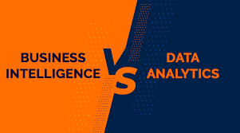

Slide 6
Data Science vs. Business Intelligence
Feature | Data Science | Business Intelligence (BI)
Focus | Discovering hidden patterns and predicting future trends | Analyzing past data to understand current performance
Data Type | Both structured and unstructured | Primarily structured data
Tools and Techniques | Statistical modeling, machine learning, deep learning, Python, R, SQL | Data warehousing, OLAP, reporting tools, SQL, Excel
Skillset | Strong in mathematics, statistics, programming, and domain expertise | Business acumen, data analysis, visualization, and reporting skills
Output | Predictive models, algorithms, machine learning models | Reports, dashboards, KPIs, visualizations
Time Horizon | Future-oriented | Past and present focused
Complexity | High | Medium to high
Role | Data scientist, machine learning engineer | Business analyst, data analyst, BI developer

Slide 7
Data Science vs. Business Intelligence
Data Science
Business Intelligence
Machine Learning vs. Traditional Statistics: Understanding the key differences and when to use each.
Data Science Lifecycle: A detailed breakdown of the various stages involved in a data science project.
Specific Data Science Techniques: Deep dive into techniques like regression, classification, clustering, or natural language processing.
Data Science Tools and Libraries: Comparison of popular tools like Python, R, TensorFlow, and PyTorch.
Data Warehousing vs. Data Lakes: Understanding the distinctions between these data storage approaches.
OLAP vs. OLTP: Differences in these database systems and their applications in BI.
BI Tools and Platforms: Overview of popular BI tools like Tableau, Power BI, and Looker.
Data Visualization Best Practices: Creating effective and informative visualizations.

Slide 8
Data Science and Business Intelligence Intersection
Data-Driven Decision Making:
How data science and BI work together to support business decisions.
Challenges and Opportunities:
Exploring the common challenges and potential benefits of combining these fields.
Case Studies:
Real-world examples of successful data science and BI implementations.

Slide 9
The Business Demand for Data, Information, and Analytics Data must be transformed to make it fit with the five Cs of data:
Clean
Consistent
Conformed
Current
Comprehensive

Slide 10
Importance of Data in Enterprises
Enterprises need data to understand various aspects of their operations, customers, competitors, suppliers, partners, employees, and stockholders.
Effective data management helps them:
Learn about business activities.
Analyze operations.
React to internal and external pressures.
Make informed decisions to manage costs, grow revenues, and increase profits.

Slide 11
Big Data Dynamics in Enterprises Volume, Variety, and Velocity
Volume
Explosive Growth: Experts estimate that 90% of the world's data today was created in the last two years. This isn't just from social media chatter but includes data from various activities. For example, Radio Frequency Identification (RFID) technology tracks products from manufacturing to purchase, contributing to vast data categories that didn't exist before.
Significance of Data: While not all collected data is crucial, the sheer volume presents a significant challenge.
Velocity
Time Sensitivity: Many data types are time-sensitive, increasing the pressure to reduce the interval between data capture and its use in reporting. Quick data processing is essential for activities like fraud detection in banking, where immediate notifications allow swift actions.
Real-Time Interaction: Businesses use current data for real-time interactions with customers, suppliers, partners, and other stakeholders.
Variety
Expanding Sources: Data sources are diversifying, adding complexity. Unstructured data (audio, video, social media) and semistructured data (XML, RSS feeds) require different handling compared to traditional structured data.
Modern Challenges: Previously, CIOs only dealt with back-office data, but now data comes from tweets, machine outputs, processes, and applications worldwide. Handling data from these diverse sources, including user-generated content in spreadsheets and documents, is a new challenge.
Data Organization: Despite the ability to gather vast amounts of data, enterprises struggle with organizing and understanding it. Data only holds value if it can be comprehended, analyzed, and utilized for actionable insights.
Notes:
the challenges and dynamics of data management in enterprises, emphasizing the increasing volume, velocity, and variety of data.
Big Data Dynamics in Enterprises
Enterprises are not just accumulating data in increasing volumes; the variety and velocity of data are also on the rise. The emergence of "Big Data" databases has amplified the ability to gather data, but regardless of scale, data complexities persist.

Slide 12
Business Intelligence
BI is the process of collecting, storing, analyzing, and visualizing data to support better business decision-making.
Key components:
Data collection and integration
Data warehousing
Data mining and analysis
Reporting and visualization
Business performance management
Example:
Sales data analysis to identify top-selling products and customer segments.

Slide 13
What is Analytics?
Analytics is the process of discovering meaningful patterns in data through statistical methods and algorithms.
Types of analytics:
Descriptive analytics (What happened?)
Diagnostic analytics (Why did it happen?)
Predictive analytics (What will happen?)
Prescriptive analytics (What should we do?)
www.expressanalytics.com
www.expressanalytics.com
Example:
Using predictive analytics to forecast sales for the next quarter.

Slide 14
Relationship between BI and Analytics
BI provides the foundation for analytics.
Analytics transforms data into actionable insights.
Together, they drive data-driven decision-making.
Image:
Venn diagram showing the overlap between BI and analytics.

Slide 15
Principles of BI and Analytics
Data quality:
Accurate, complete, consistent, relevant, timely data.
Data governance:
Clear policies and procedures for data management.
Data security:
Protecting sensitive data from unauthorized access.
Data visualization:
Effective presentation of data through charts, graphs, and dashboards.
Business alignment:
Ensuring BI and analytics support business goals.

Slide 16
Applications of BI and Analytics
Sales and marketing:
Customer segmentation,
sales forecasting,
campaign performance analysis.
Finance:
Financial forecasting,
fraud detection,
risk assessment.
Operations:
Supply chain optimization,
inventory management,
quality control.
Human resources:
Employee performance analysis,
talent management,
workforce planning.
Other industries:
Healthcare
Education
government, etc.

Slide 17
Data-driven Decision-making
Data-driven decision-making refers to the process of making organizational decisions based on actual data rather than intuition or observation alone.
The rise of big data, advanced analytics, and machine learning has equipped organizations with tools to extract meaningful insights from vast amounts of data.
By relying on data, organizations can reduce risks, improve accuracy, and optimize outcomes.
Let’s consider a simple example: Imagine a retail company trying to decide which products to stock during the holiday season.
Instead of relying on a manager’s intuition or last year’s trends, they analyze sales data, customer preferences, and market trends to predict the most popular items.
This approach increases the likelihood of higher sales and customer satisfaction.

Slide 18
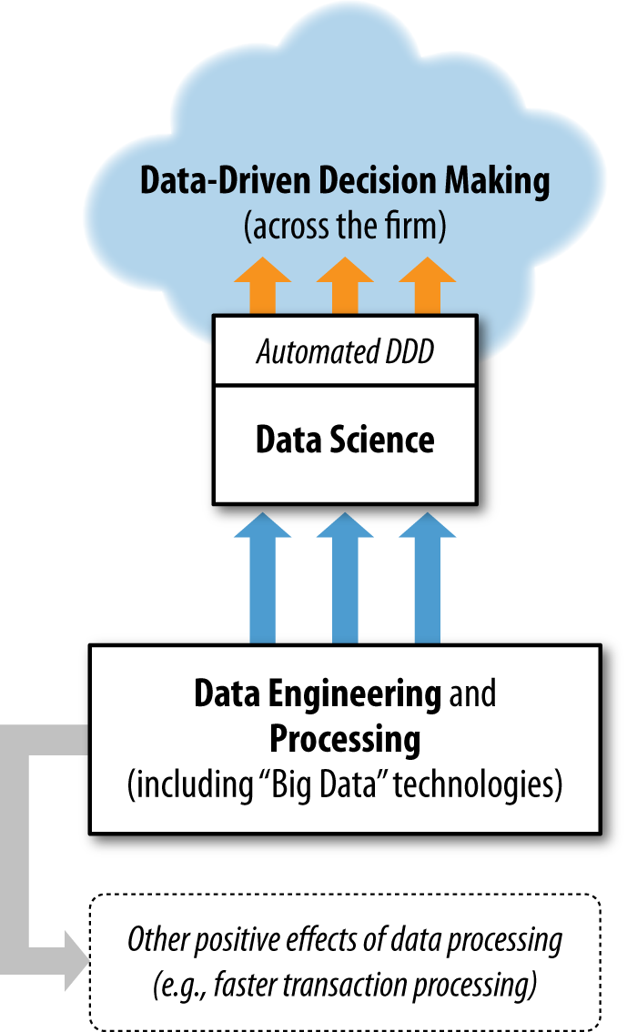

Slide 19
The Importance of Data in Modern Organizations
Improved Decision Accuracy: Decisions backed by data are more likely to be accurate and effective. For instance, a financial institution using data to assess credit risks can significantly reduce the likelihood of default.
Increased Efficiency: Data-driven decisions can streamline operations. For example, by analyzing supply chain data, a company can optimize inventory levels, reducing costs and avoiding stockouts.
Competitive Advantage: Organizations that leverage data effectively can gain a significant edge over competitors. Companies like Amazon and Netflix use data to personalize recommendations, which enhances customer experience and drives sales.
Risk Mitigation: Data can help identify potential risks before they become critical issues. For example, predictive analytics can alert an organization to potential equipment failures, allowing for proactive maintenance.

Slide 20
Steps in the Data-driven Decision-making Process
Identify the Problem or Opportunity:
The first step is to clearly define the problem you’re trying to solve or the opportunity you want to explore. For instance, a company might want to understand why its customer retention rates are declining.
Collect Relevant Data:
Once the problem is defined, the next step is to gather the necessary data. This could be internal data from your organization’s systems, such as sales records or customer feedback, or external data like market trends or competitor analysis.
Clean and Prepare the Data:
Raw data often needs to be cleaned and formatted before it can be analyzed. This process might involve removing duplicates, correcting errors, and organizing the data into a usable format.
Analyse the Data:
After the data is prepared, it’s time to analyze it. Various techniques can be used, depending on the nature of the data and the question at hand. For example, statistical analysis, machine learning models, or visualization tools can help uncover patterns and insights.
Interpret the Results:
Data analysis will produce results, but those results need to be interpreted in the context of the original problem. For example, if the analysis shows that customer retention is lower among a specific demographic, the organization needs to understand why this is happening.
Make the Decision:
Armed with insights from the data, the organization can make a decision. For example, they might decide to launch a targeted marketing campaign aimed at the demographic with lower retention rates.
Implement the Decision:
Once a decision is made, it needs to be implemented. This could involve changes to processes, launching new initiatives, or adjusting strategies.

Slide 21
Challenges in Data-driven Decision-making
Data Quality Issues: Poor-quality data can lead to incorrect conclusions and flawed decisions. Organizations must ensure their data is accurate, complete, and up-to-date.
Data Overload: With so much data available, organizations can easily become overwhelmed. The challenge is to filter out the noise and focus on the data that’s truly relevant.
Complexity of Data Analysis: Analyzing data, especially large and complex datasets, requires specialized skills and tools. Not all organizations have the necessary expertise in-house.
Resistance to Change: Implementing data-driven decision-making often requires a cultural shift within the organization. Employees who are used to making decisions based on intuition or experience might resist this change.
Ethical Considerations: The use of data, especially personal data, raises ethical concerns. Organizations must navigate issues related to privacy, consent, and data security.

Slide 22
Case Studies and Examples
Google’s A/B Testing:
Google is known for its data-driven approach. One example is its use of A/B testing to improve user experience.
By testing different versions of a webpage or app, Google can make data-backed decisions about which version performs better.
Target’s Predictive Analytics:
Target, the retail giant, uses predictive analytics to anticipate customer needs.
By analyzing purchase history and other data points, Target can predict when customers might need certain products and send targeted promotions.
UPS’s ORION System:
UPS developed a route optimization system called ORION, which uses data to determine the most efficient delivery routes.
This system has saved UPS millions of miles and gallons of fuel, reducing costs and environmental impact

Slide 23
Defining a Data Warehouse
A data warehouse is a centralized repository that stores integrated data from multiple sources. It is designed to support decision-making by providing a unified view of the data.

Slide 24
High-level Perspective on DW/BI Systems
Definition :
Data Warehousing and Business Intelligence (DW/BI) systems are strategic tools used by organizations to store, manage, and analyze large volumes of data.
The primary goal of these systems is to transform raw data into meaningful insights that can guide business decisions.
Holistic View:
Instead of focusing solely on the technical aspects, a high-level perspective considers DW/BI systems as integral components of an organization’s overall strategy.
This viewpoint emphasizes how these systems contribute to business objectives, streamline operations, and enable data-driven decision-making across all levels of the organization.
Interconnectedness:
DW/BI systems do not operate in isolation; they are deeply interconnected with other business processes, such as finance, marketing, and operations.
A high-level perspective acknowledges these connections and seeks to optimize the flow of information across departments to maximize the value derived from the data.

Slide 25
Emphasis on Business Needs Before Technology
Business-Driven Approach:
The success of a DW/BI system depends on its alignment with the specific needs and goals of the business.
This approach prioritizes understanding the key questions, challenges, and opportunities that the business faces before diving into technology decisions.
Avoiding Technology-First Pitfalls:
A common mistake in DW/BI projects is to start with selecting tools and technologies without fully understanding what the business needs.
This can lead to the implementation of systems that are either overly complex or insufficient to meet the business's requirements, resulting in wasted resources and missed opportunities.
Business Requirements Gathering:
This involves engaging with business stakeholders to clearly define their objectives, the metrics they need to track, the type of reports and analyses they require, and how they intend to use the data.
This ensures that the DW/BI system is purpose-built to support the business's strategic goals.

Slide 26
Importance of Working Backward from Business Needs to Design and Technology Choices
Backward Design Philosophy:
Starting with the end goals in mind, the process involves working backward to determine the necessary data structures, analytical processes, and finally, the technology stack that will support these requirements.
This ensures that every aspect of the DW/BI system is purposefully aligned with achieving the desired business outcomes.
Logical and Physical Design:
Once business needs are clearly understood, the next step is to design the logical data models that will organize the data in a way that best supports those needs.
This involves defining dimensions, facts, and relationships in a way that mirrors the business's operational realities.
Following this, the physical design phase focuses on how this logical model will be implemented using specific technologies, databases, and hardware configurations.

Slide 27

Importance of Working Backward from Business Needs to Design and Technology Choices
Technology Selection:
The choice of technology and tools should come last, guided by the requirements established in the previous steps.
This ensures that the selected tools are capable of supporting the designed system and that the technology fits the business's scale, complexity, and budget.
Adaptability and Scalability:
By focusing on business needs first, the DW/BI system is more likely to be adaptable and scalable, capable of evolving as the business grows and its data needs become more complex.
This backward approach reduces the risk of costly redesigns or system overhauls in the future.

Slide 28

DW/BI Systems Must Align with Business Objectives
Alignment with Strategic Goals:
The primary purpose of a Data Warehousing and Business Intelligence (DW/BI) system is to support the strategic goals of the business.
Whether the organization aims to increase revenue, improve customer satisfaction, optimize operations, or gain a competitive advantage, the DW/BI system should be designed to provide insights that directly contribute to these objectives.
Enabling Data-Driven Decisions:
For a DW/BI system to be effective, it must provide actionable insights that align with the key performance indicators (KPIs) and metrics that the business prioritizes.
This ensures that decision-makers at all levels can rely on accurate and relevant data to guide their strategies and actions.
Customization to Business Needs:
Each organization has unique business objectives, which means that a one-size-fits-all approach to DW/BI will not work.
The system must be customized to reflect the specific goals, processes, and challenges of the organization, ensuring that the data collected, stored, and analysed is directly relevant to the business's needs.

Slide 29
Similarities Between DW/BI Managers and Publishers in Terms of Responsibility
Curating and Delivering Content:
Much like publishers, DW/BI managers are responsible for curating and delivering information that is accurate, timely, and valuable to their audience.
Publishers ensure that content is well-organized, accessible, and relevant to readers; similarly, DW/BI managers ensure that data is processed, structured, and presented in a way that meets the needs of business users.
Ensuring Quality and Integrity:
Both publishers and DW/BI managers share the responsibility of maintaining the quality and integrity of the information they manage.
For publishers, this means adhering to editorial standards and avoiding misinformation.
For DW/BI managers, it involves ensuring data accuracy, consistency, and reliability, as these factors are critical for making informed business decisions.

Slide 30
Similarities Between DW/BI Managers and Publishers in Terms of Responsibility
Balancing User Needs with Technical Constraints:
Just as publishers must balance reader interests with the realities of production schedules and budgets, DW/BI managers must balance the needs of business users with the technical constraints of data systems.
This includes managing the expectations of stakeholders while ensuring that the DW/BI system remains scalable, efficient, and within budget.
Audience Understanding:
Both roles require a deep understanding of their audience.
Publishers need to know their readers' preferences and demands, while DW/BI managers need to understand the information requirements of different business units and decision-makers.
This understanding guides the creation and delivery of content (or data) that is tailored to meet the specific needs of the audience.

Slide 31
Importance of Considering Business Needs First
Foundation of System Design:
The effectiveness of a DW/BI system hinges on its ability to meet the specific needs of the business.
Before any technical decisions are made, it’s crucial to identify and understand what the business needs from the system—what questions it needs to answer, what problems it needs to solve, and what decisions it needs to support.
Avoiding Misalignment:
When business needs are not the primary focus, there is a risk of creating a system that is technically robust but fails to deliver the insights or functionality that the business requires.
This misalignment can lead to underutilization of the system, wasted resources, and ultimately, failure to achieve the desired business outcomes.
Guiding Technology and Design Choices:
Understanding business needs first helps in making informed decisions about the system’s architecture, data models, and the selection of tools and technologies.
For example, if the business requires real-time analytics, this will influence the choice of a data processing engine, the structure of the data warehouse, and the design of the data pipelines.

Slide 32
Importance of Considering Business Needs First
Ensuring User Adoption:
A DW/BI system that is designed with business users in mind is more likely to be adopted and utilized effectively.
When users see that the system addresses their specific needs and helps them achieve their goals, they are more likely to engage with it regularly and integrate it into their decision-making processes.
Future-Proofing the System:
By focusing on business needs, the DW/BI system is better positioned to adapt to changes in business strategy or market conditions.
As the organization evolves, the system can be scaled and modified to continue providing relevant insights, ensuring long-term value and sustainability.

Slide 33
Data Warehousing, Business Intelligence, and Dimensional Modeling Primer

Slide 34
Index
Business-driven goals of data warehousing and business intelligence
Publishing metaphor for DW/BI systems
Dimensional modeling core concepts and vocabulary, including fact and dimension tables
Kimball DW/BI architecture's components and tenets
Comparison of alternative DW/BI architectures, and the role of dimensional modeling within each
Misunderstandings about dimensional modeling

Slide 35
Operational Systems vs. DW/BI Systems: Different Purposes
Operational Systems:
Designed for day-to-day business operations, focusing on recording and processing individual transactions.
Characteristics:
High-speed transaction processing
Focus on current data without maintaining extensive historical records
Repetitive execution of business processes
DW/BI Systems:
DW/BI systems are designed for analysis and decision-making.
Characteristics:
Optimized for high-performance data retrieval and analysis
Focus on aggregated data and historical context
Support complex queries that analyze multiple transactions together
For example, they handle tasks like order entry, customer registration, and activity monitoring.
Optimized for speed and efficiency, processing one transaction at a time to ensure smooth and uninterrupted business processes.
They focus on aggregating and analyzing large amounts of data to provide insights that help businesses evaluate performance and make informed decisions.
Unlike operational systems, DW/BI systems need to handle complex queries that may involve searching through large datasets and preserving historical data to allow for trend analysis and performance evaluation over time.

Slide 36
Importance of Historical Context in DW/BI Systems
Unlike operational systems that are concerned with the most current state of data, DW/BI systems require a historical context to track and evaluate the performance of various business processes over time.
01
For example, business users may need to compare sales data across different time periods, analyze customer behavior trends, or assess the effectiveness of marketing campaigns.
02
This historical data allows for a deeper understanding of patterns and trends, which is critical for strategic decision-making.
03

Slide 37
Misalignment in DW/BI System Design
Despite the distinct purposes of operational and DW/BI systems, some organizations mistakenly create DW/BI systems that are essentially copies of their operational systems.
These "pseudo" data warehouses often fail to meet the analytical needs of business users because they do not account for the different requirements of data analysis, such as the need for high-performance queries, historical data preservation, and complex data aggregation.
Issues with Misaligned DW/BI Systems:
Poor usability and performance from the perspective of business users
Inadequate support for complex, ad-hoc queries and deep data analysis
Failure to provide meaningful insights that drive business decisions

Slide 38
Fundamental Goals of DW/BI: To provide easy and reliable access to data that supports fact-based decision-making within an organization
Accessibility
Business users often struggle with accessing the vast amount of data collected by organizations.
Flexibility:
Users require the ability to "slice and dice" data, meaning they need to analyze data from various perspectives and combinations.
Simplicity:
The system should present only the most important information, eliminating unnecessary complexity.
Accuracy:
Data discrepancies lead to disagreements and hinder decision-making processes.
Fact-Based Decision Making:
Organizations desire to move towards decisions supported by solid data rather than intuition or incomplete information.

Slide 39
The Purpose of Data Modeling
Importance of data modeling:
Foundation for business intelligence and data warehousing applications.
Benefits of effective data modeling:
Consistent, comprehensive, and current data.
Transformation of data:
From operational systems to data warehouse, data marts, and OLAP cubes.

Slide 40
Logical Data Modeling Approaches
Entity-Relationship (ER) Modeling:
Baseline for operational data model.
Used to establish relationships between entities and attributes.
Dimensional Modeling:
Cornerstone of BI and DW applications.
Focuses on organizing data for analytical purposes.

Slide 41
Key Concepts of ER Modeling
Entities: Objects or concepts within a system (e.g., customers, products, orders).
Attributes: Properties or characteristics of entities (e.g., customer name, product price).
Relationships: Connections between entities (e.g., one-to-one, one-to-many, many-to-many).
Cardinality: The number of instances of one entity that can be related to instances of another entity.
Modality: The minimum number of instances of one entity that can be related to instances of another entity.

Slide 42
Steps in ER Modeling
Identify entities: Determine the key objects or concepts in the system.
Define attributes: Identify the relevant properties or characteristics of each entity.
Establish relationships: Connect entities based on their associations.
Specify cardinality and modality: Define the rules governing the number of instances involved in each relationship.
Create an ER diagram: Visually represent the entities, attributes, and relationships.

Slide 43
Best Practices in ER Modeling
Normalization: Ensure data integrity and avoid redundancy.
Data granularity: Determine the appropriate level of detail for data.
Data consistency: Maintain consistency across different data sources.
Performance optimization: Consider query performance when designing the model.
Flexibility: Design the model to accommodate future changes.

Slide 44
Difference Between Data Model and Data Modeling
Feature | Data Model | Data Modeling
Definition | A specification of data structures and business rules representing business requirements. | A structured approach to identify and analyze data components of the information system specifications.
Purpose | Serves as a blueprint for data design in IT applications. | Involves the process of creating and refining data models.
Focus | Data structures, relationships, and business rules. | The methodology and steps involved in creating data models.
Output | A visual representation of the data (e.g., ER diagram). | A well-structured data model.
Role in Application Development | Provides the foundation for data design and implementation. | Ensures that the data model is appropriate for building the application.

Slide 45
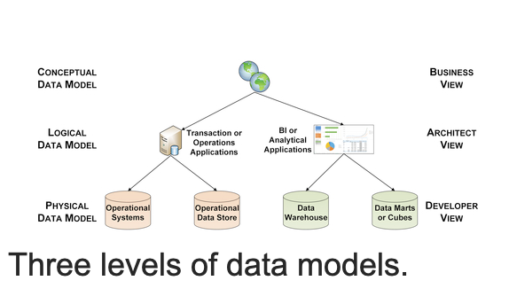

Slide 46
Three Levels of Data Models
Importance of data models in building effective BI applications.
Three levels of data modeling:
Conceptual
Logical
Physical

Slide 47
The Conceptual Data Model: High-Level Business View
Focus: Representing high-level business entities and relationships.
Purpose: Provides a common understanding for business and IT teams.
Characteristics:
Entity-Relationship Diagram (ERD) format.
Business-oriented terms (e.g., customers, products, orders).
Independent of specific database technology.
Benefits:
Facilitates communication between business and IT.
Defines the overall data scope for the system.
Serves as a foundation for more detailed models.

Slide 48
The Logical Data Model: Bridging the Gap
Focus: Translating business requirements into technical data structures.Purpose: Provides a blueprint for the database design.Characteristics:Based on the conceptual model with additional details.
Includes data types, constraints, and keys.
Uses normalized structures for data integrity.
Benefits:Serves as a reference for data architects and developers.
Defines data relationships in a more technical format.
Enables validation of business and data requirements.

Slide 49
The Physical Data Model: Tailored for Implementation
Focus: Defining how data will be stored in the specific database.
Purpose: Provides the blueprint for database creation.
Characteristics:
Based on the logical model with DBMS-specific details.
Includes tables, columns, data types, and physical constraints.
Optimized for performance and scalability.
Benefits:
Guides database administrators and developers in building the system.
Ensures efficient data storage and retrieval.
Accounts for limitations and functionalities of the chosen DBMS.

Slide 50
Relationship Between the Levels
Sequential progression: Conceptual -> Logical -> Physical.
Each level builds upon the previous one, adding more detail.

Slide 51
Use Cases for Different Models
Conceptual Model: Foundation for understanding business processes and data needs.
Logical Model: Essential for designing BI applications (DW, data marts, OLAP cubes).
Physical Model: Specific implementation for operational systems (ERP) and BI applications.

Slide 52
System Requirements Driven by Business Goals:
Ease of Access:
To be truly useful, the DW/BI system must be designed with the end-user in mind.
The data should be structured in a way that is easy for business users to navigate, understand, and use.
This includes using familiar terminology and organizing data in ways that reflect how users think about their business.
Consistency:
Trust in the system is built on consistency.
If the data is not reliable or if there are inconsistencies in how data is labeled or presented, users will lose confidence in the system, rendering it ineffective.
Adaptability:
Change is inevitable in business environments.
The DW/BI system must be flexible enough to adapt to new data sources, changing business conditions, and evolving user needs without causing disruptions.

Slide 53
System Requirements Driven by Business Goals:
Timeliness:
In many cases, timely access to data is critical for making effective decisions.
The DW/BI system must be capable of delivering information quickly enough to be useful in fast-paced decision-making scenarios.
Security:
Protecting data is of paramount importance, especially when it contains sensitive business information.
A robust security framework is essential to prevent unauthorized access and ensure that only those who need the data can access it.
Authority and Trustworthiness:
The DW/BI system must be seen as the definitive source of truth within the organization.
If the data it provides is inaccurate or unreliable, it will undermine the very purpose of the system.
User Acceptance:
Even the most technically advanced DW/BI system will fail if it is not embraced by its intended users.
Ensuring that the system is user-friendly and meets the business needs is key to achieving widespread adoption and usage.

Slide 54
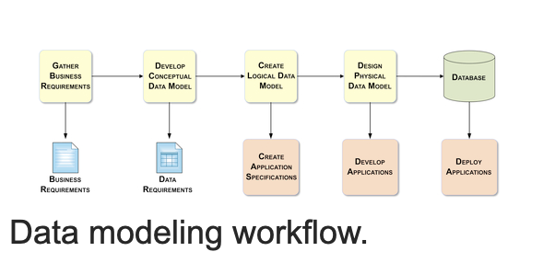
Data Modeling Workflow

Slide 55
Data Modeling Workflow
Gather
Gather Business Requirements:
Reference: Business Analyst or Subject Matter Experts
Notes: Understand the business objectives, processes, and data needs. Identify key entities, attributes, and relationships.
Analyze
Analyze Data Needs:
Reference: Business Requirements Document
Notes: Analyze the data required to support the business processes and objectives. Identify data sources and their formats.
Identify
Identify Data Relationships:
Reference: Business Requirements, Data Analysis
Notes: Determine how different data elements are connected and related to each other. Identify parent-child relationships, associations, and dependencies.
Create
Create Data Models:
Reference: Data Analysis, Data Relationships
Conceptual data Model , logical data mpdel , Physical data model

Slide 56
Data Modeling Workflow
Support
Support Application Development:
Reference: Data Models, Application Developers
Notes: Provide guidance and support to application developers, ensuring they adhere to the data model and understand data relationships.
Create
Create Application Specifications:
Reference: Data Models, Business Requirements
Notes: Define the functional and non-functional requirements for the application, including data input, processing, output, and storage.
Develop
Develop Applications:
Reference: Application Specifications, Data Models
Notes: Build the application code based on the specifications, ensuring it interacts with the data model and meets business requirementscorrectly.
Deploy
Deploy Applications:
Reference: Developed Applications, Testing
Notes: Deploy the applications to the production environment, ensuring proper integration with the data model and systems.

Slide 57
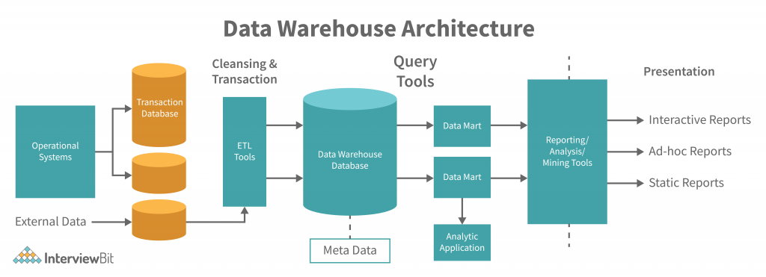

Slide 58
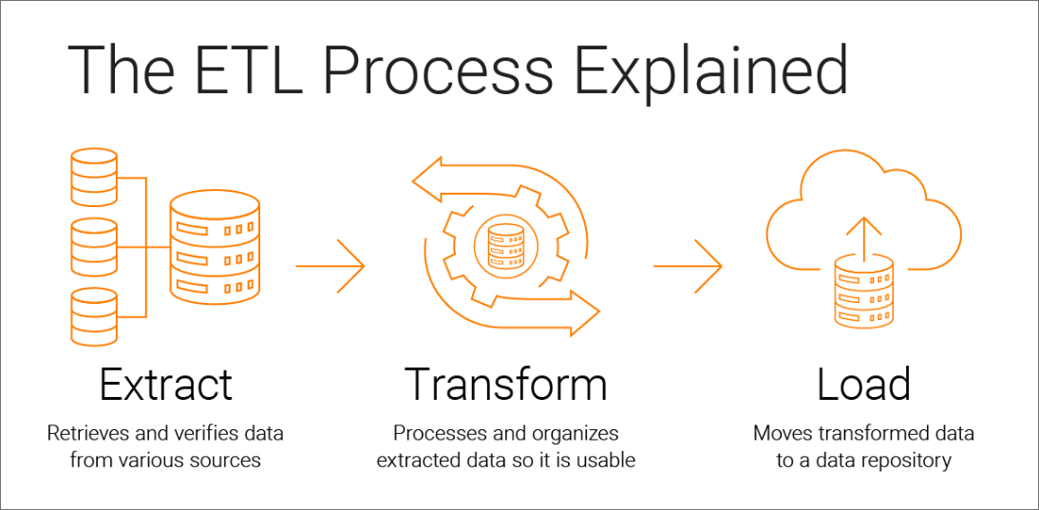

Slide 59
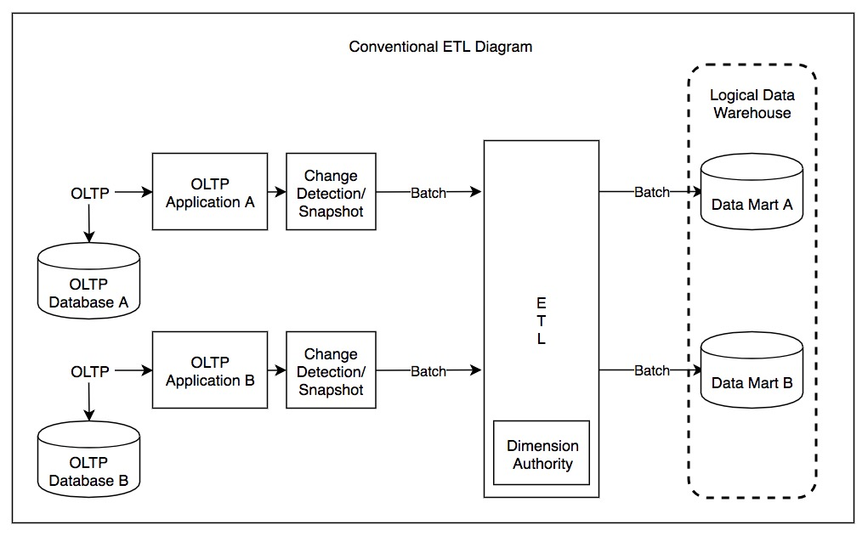
https://images.app.goo.gl/DQ11tBfcc8pQsKDR9

Slide 60
ETL (Extract, Transform, Load) Processes ETL is a series of steps involved in moving data from source systems to a data warehouse.
1. Extract:
Data Source: Identifies the source systems where the data resides (e.g., databases, flat files, APIs).
Data Extraction: Extracts data from these sources based on defined criteria.
Data Cleansing: Cleanses the extracted data to remove inconsistencies, errors, and duplicates.
2. Transform:
Data Standardization: Converts data into a consistent format and structure.
Data Integration: Combines data from multiple sources into a unified view.
Data Aggregation: Aggregates data into summary levels (e.g., daily, monthly, yearly).
Data Enrichment: Adds context or additional information to the data.
Data Quality: Ensures data quality through validation, cleansing, and transformation rules.
3. Load:
Data Transfer: Transfers the transformed data into the data warehouse.
Data Storage: Stores the data in the data warehouse's storage format (e.g., relational databases, data marts).
Data Indexing: Creates indexes to improve query performance.

Slide 61

ETL Tools
Talend
Informatica PowerCenter
IBM DataStage
Microsoft SSIS (SQL Server Integration Services)
Pentaho Data Integration

Slide 62
Benefits of Data Warehousing and ETL
Improved Decision Making:
Provides valuable insights for strategic planning and decision-making.
Enhanced Business Intelligence:
Supports business intelligence initiatives by providing a centralized data repository.
Data Consistency:
Ensures data consistency and accuracy across the organization.
Scalability:
Can handle large volumes of data and support growing business needs.
Data Governance:
Enables effective data governance and management.

Slide 63
ETL Subsystems
The 34 subsystems identified by the Kimball Group provide a structured framework for designing and building ETL systems.
These subsystems can be categorized into four primary areas:
Extracting
Cleaning and Conforming
Delivering
Managing

Slide 64
Extract
Data Profiling:
Understanding the source data's structure, quality, and suitability for inclusion.
Change Data Capture (CDC):
Identifying and capturing only the changes in source systems to minimize data transfer.
Extract System:
The actual mechanism for extracting data from source systems.

Slide 65
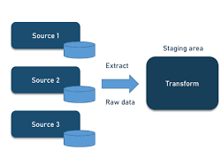
Extract

Slide 66
Cleaning and Conforming
Data Cleansing: Removing inconsistencies, errors, and duplicates from the extracted data.
Data Quality Screens: Implementing checks and validations to ensure data quality.
Data Type Conversion: Converting data to appropriate formats (e.g., date, numeric).
Data Standardization: Ensuring consistent formats and standards across different data sources.
Data Enrichment: Adding context or additional information to the data.
Dimensional Structures: Creating dimensional models to organize data into fact and dimension tables.

Slide 67
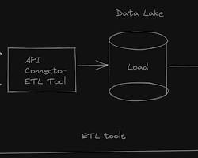
Cleaning and Conforming

Slide 68
Delivering
Load System:
The mechanism for transferring data from the ETL system to the data warehouse.
Data Purging:
Removing outdated or unnecessary data from the data warehouse.
Data Partitioning:
Dividing data into smaller, manageable partitions for improved performance.
Data Indexing:
Creating indexes to optimize query performance.
Data Compression:
Compressing data to reduce storage requirements.

Slide 69
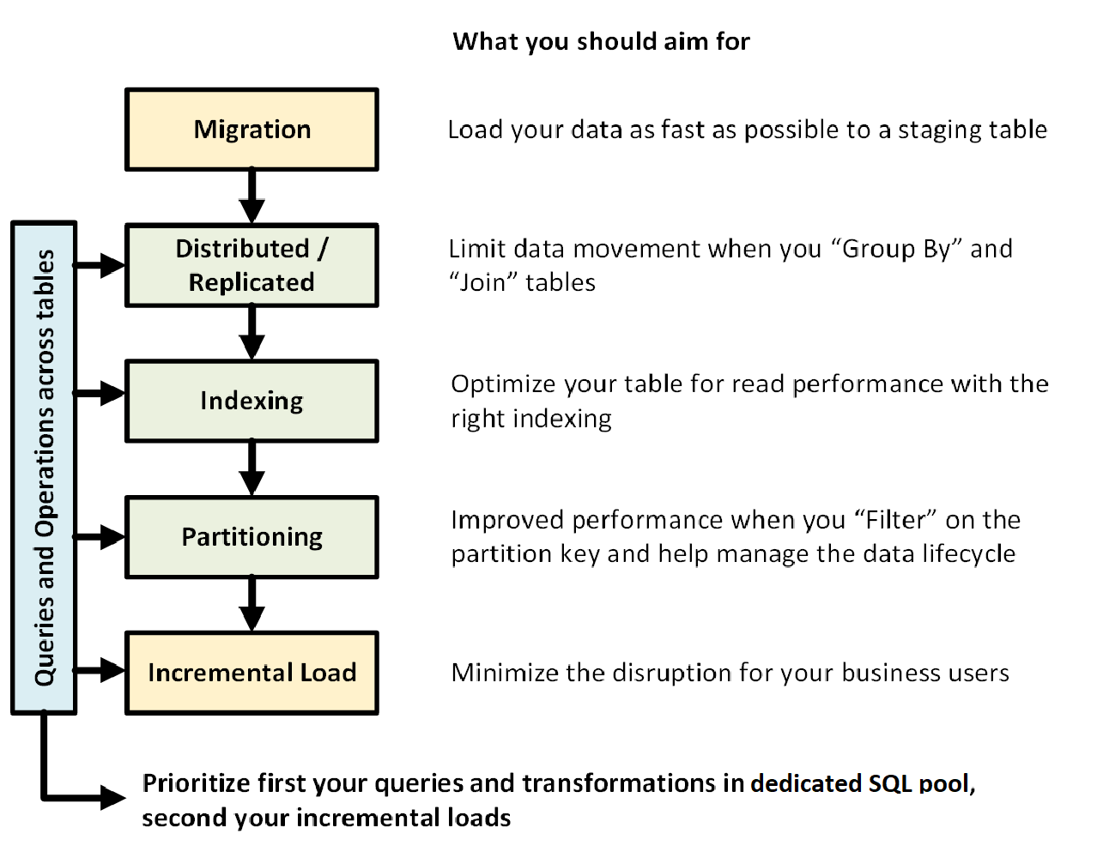
Delivering

Slide 70
Managing
ETL Scheduling:
Scheduling ETL jobs to run at specific times or intervals.
ETL Monitoring:
Monitoring ETL job execution, performance, and error handling.
ETL Error Handling:
Implementing mechanisms to handle errors and exceptions during ETL processes.
ETL Documentation:
Documenting ETL processes, procedures, and configurations.
ETL Version Control:
Managing changes to ETL code and configurations.

Slide 71
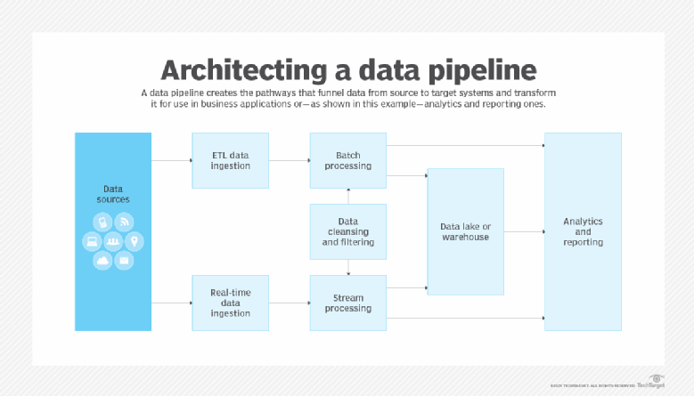

Slide 72
Example: E-commerce Data Warehouse
Extracting:
Extracting sales data from transactional databases, product data from a product catalog, and customer data from a customer database.
Cleaning and Conforming:
Cleansing the data for inconsistencies (e.g., incorrect dates, missing values), standardizing product categories, and enriching customer data with demographic information.
Delivering:
Loading the cleansed and transformed data into fact tables (e.g., sales facts) and dimension tables (e.g., product dimensions, customer dimensions).
Managing:
Scheduling ETL jobs to run daily or hourly, monitoring job execution for errors, and documenting the ETL process.

Slide 73
Ethical and legal considerations in big data analytics
Consideration | Ethical Concerns | Legal Concerns
Data Privacy | Respecting individuals' privacy, preventing unauthorized access or misuse of personal data. | Compliance with privacy laws (e.g., GDPR, CCPA), ensuring individuals' rights to access, correct, and delete their data.
Data Security | Protecting data from unauthorized access, breaches, and theft. Implementing robust security measures. | Legal consequences for data breaches, including fines and lawsuits. Compliance with data protection laws like GDPR.

Slide 74
Ethical and legal considerations in big data analytics
Consideration | Ethical Concerns | Legal Concerns
Informed Consent | Obtaining informed consent from individuals before data collection. Ensuring users are aware of data use and sharing. | Laws require explicit consent before processing personal data. Non-compliance can lead to legal action.
Bias and Fairness | Avoiding the perpetuation or amplification of biases. Ensuring algorithms do not lead to unfair treatment. | Legal prohibitions against discrimination based on protected characteristics. Ensuring analytics do not result in discriminatory practices.

Slide 75
Ethical and legal considerations in big data analytics
Consideration | Ethical Concerns | Legal Concerns
Transparency and Accountability | Being transparent about data use, methodologies, and algorithms. Building trust and allowing for scrutiny. | Regulations may require explanations for automated decisions that significantly affect individuals. Lack of transparency can lead to legal challenges.
Data Ownership and Intellectual Property | Ensuring proper authorization for data use and crediting data originators. Addressing ethical issues of data sharing and ownership. | Intellectual property laws protect data and algorithms. Violations can result in disputes over ownership and copyright infringement.

Slide 76
Ethical and legal considerations in big data analytics
Consideration | Ethical Concerns | Legal Concerns
Social Impact | Considering the societal consequences of big data analytics, such as influencing public opinion or behavior. | Regulation of data use in areas like political campaigns and social media to prevent manipulation and ensure fairness.
Environmental Impact | Considering the environmental impact of data processing, including energy consumption and carbon footprint. | Emerging regulations may address the environmental impact of large-scale data processing.

Slide 77
Practical Steps for Compliance and Ethical Conduct
Regular Audits:
Conduct regular audits of data practices to ensure compliance with legal and ethical standards.
Employee Training:
Educate employees on the ethical and legal aspects of data handling, including the importance of privacy, security, and bias mitigation.
Data Governance Framework:
Implement a robust data governance framework that outlines policies, procedures, and roles related to data management.
Use of Technology:
Leverage technologies like encryption, access controls, and secure data storage solutions to enhance data security and compliance.
Ethical AI and Analytics:
Develop and use ethical AI guidelines to ensure that analytics processes are fair, transparent, and aligned with organizational values.

